Slide 1
Front End Engineering-I
CURRENCY CONVERTER
Team Details:
LAKSHAY MITTAL: 2410991250
IMAANJOT SINGH: 2410991234
LAKSHYA: 2410991253
Faculty Coordinator: Dr. NARESH KUMAR TRIVEDI
:
Chitkara University Institute of Engineering and Technology,
Chitkara University, Punjab

Slide 2

Table of Contents
Introduction
Problem Statement
Technical Details
Key Features
Project Highlights
Conclusion
References/Links used

Slide 3

INTRODUCTION
Currency Converter
It is a tool that allows users to convert the value of one currency into another based on real-time exchange rates helping with international transactions, financial comparison etc.
Team Members:
Lakshay Mittal
Imaanjot Singh
Lakshya

Slide 4
Challenges
Real Time Exchange Rate Fluctuations
Complexity of Manual Calculations
PROBLEM STATEMENT
The primary aim of our website is to automates the process of converting one currency to another, as doing it manually will make the process very difficult. Adding Further, it is often hard to access accurate and current exchange rates in a user - friendly format. A currency converter centralizes this information and presents it in a way that is easily accessible and understandable.

Slide 5


TECHNICAL DETAILS
LANGUAGES USED
HTML : We used HTML to create basic structure of our website and to add content. We organized tags as <html>, <head>, <title>, <body> and <div>.
CSS : We used CSS tools to add style such as color, size, border, flex etc. to make our website look attractive.

Slide 6

Java Script : We used Java Script to make our interactive and functional. Java Script allowed us to manipulate HTML and CSS respond to user actions, validate forms, build dynamic web applications.

Slide 7

TECHNICAL DETAILS
FRAMEWORK USED
BOOTSTRAP : We used bootstrap for various predefined utility classes like color schemes, flex utility class etc. for making our website responsive and efficient.

Slide 8
KEY FEATURES
Intuitive design for easy navigation and conversions.
We have added a favourite section so that user can add his most used currencies to that section.
We have also added a history section to view old conversions.

Slide 9
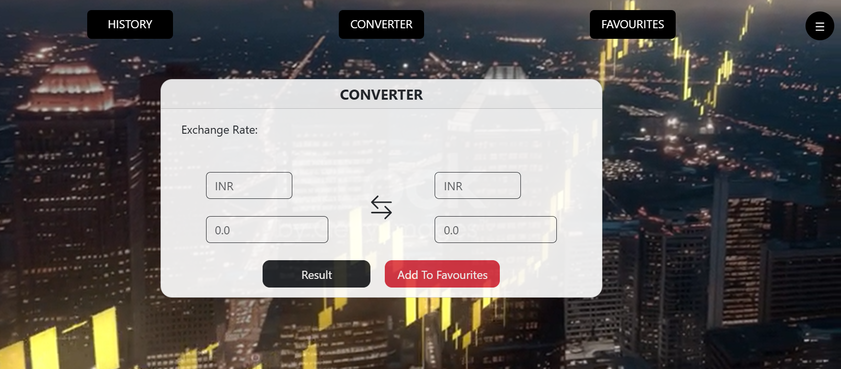
PROJECT HIGHLIGHTS

Slide 10
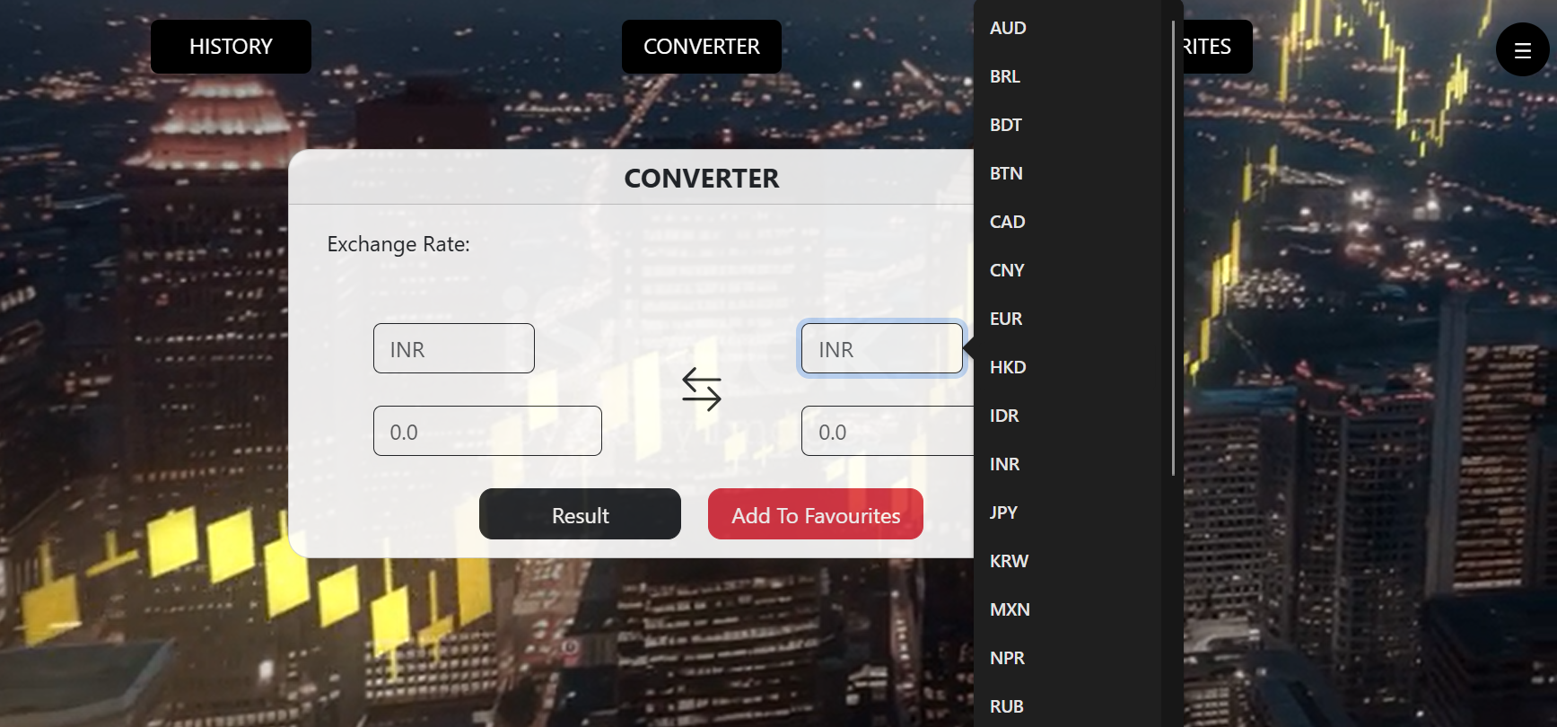

Slide 11
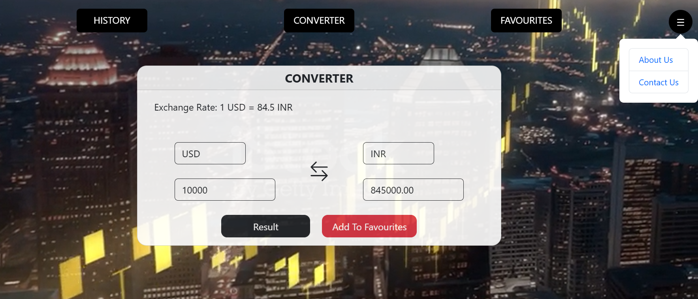

Slide 12
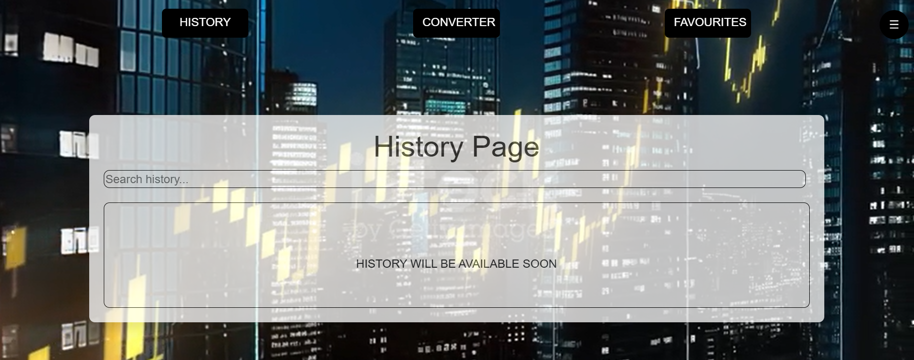

Slide 13
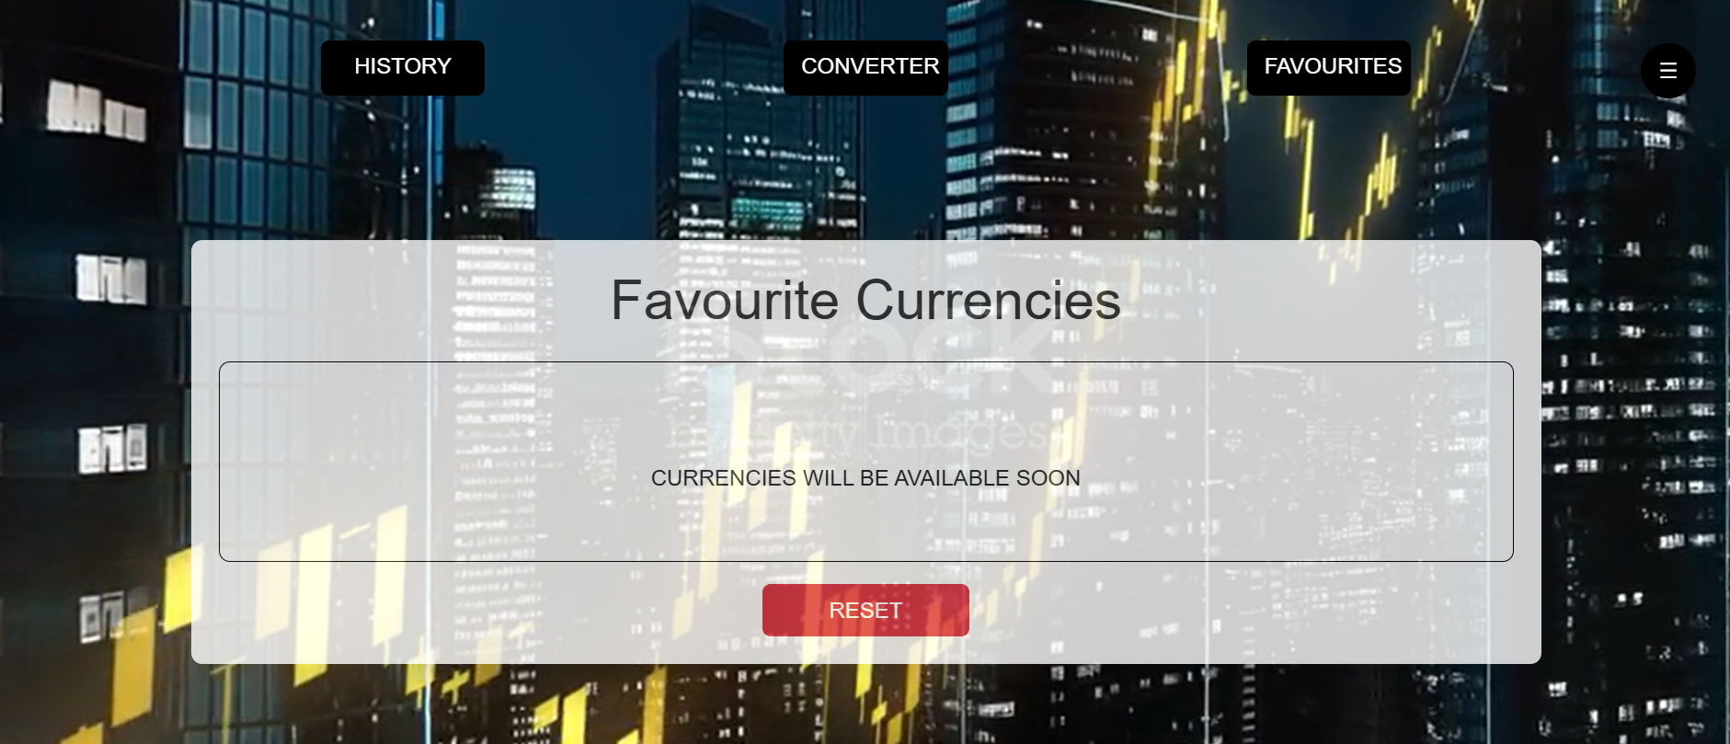

Slide 14
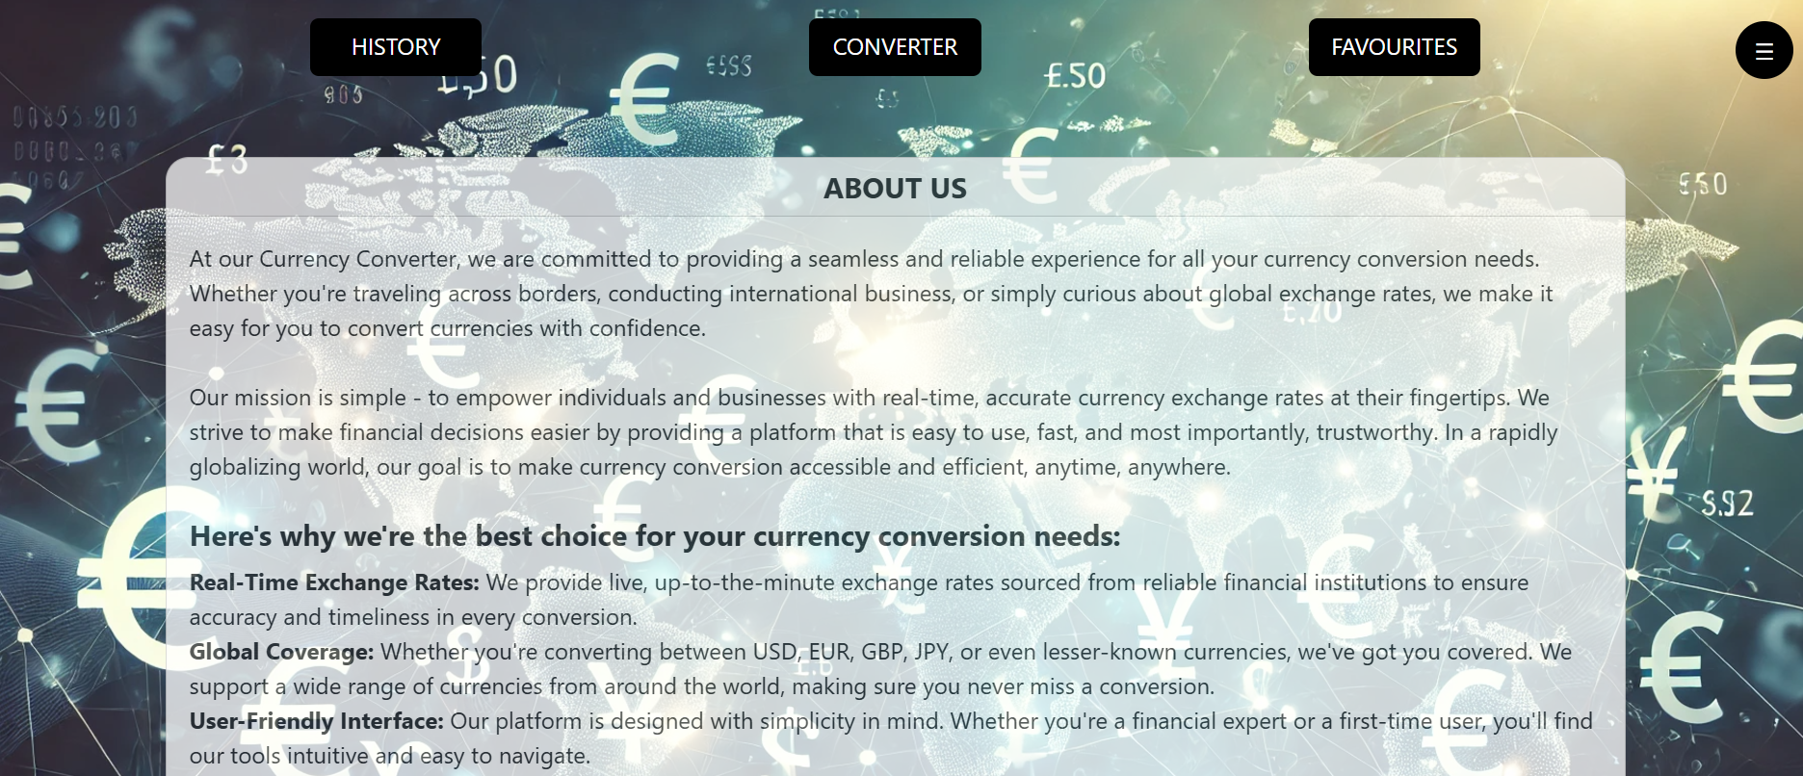

Slide 15
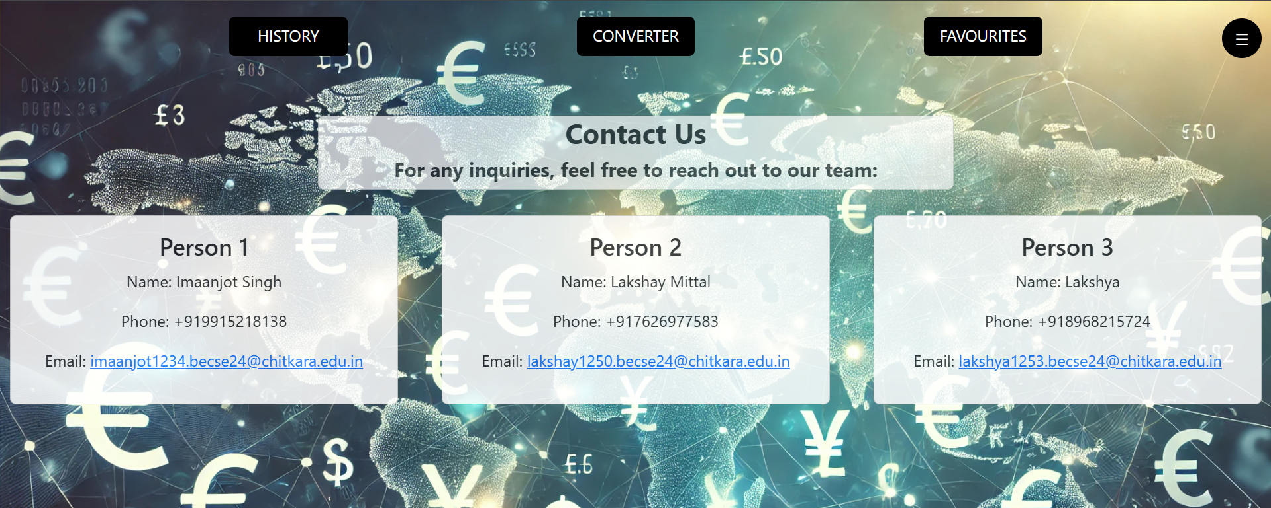

Slide 16
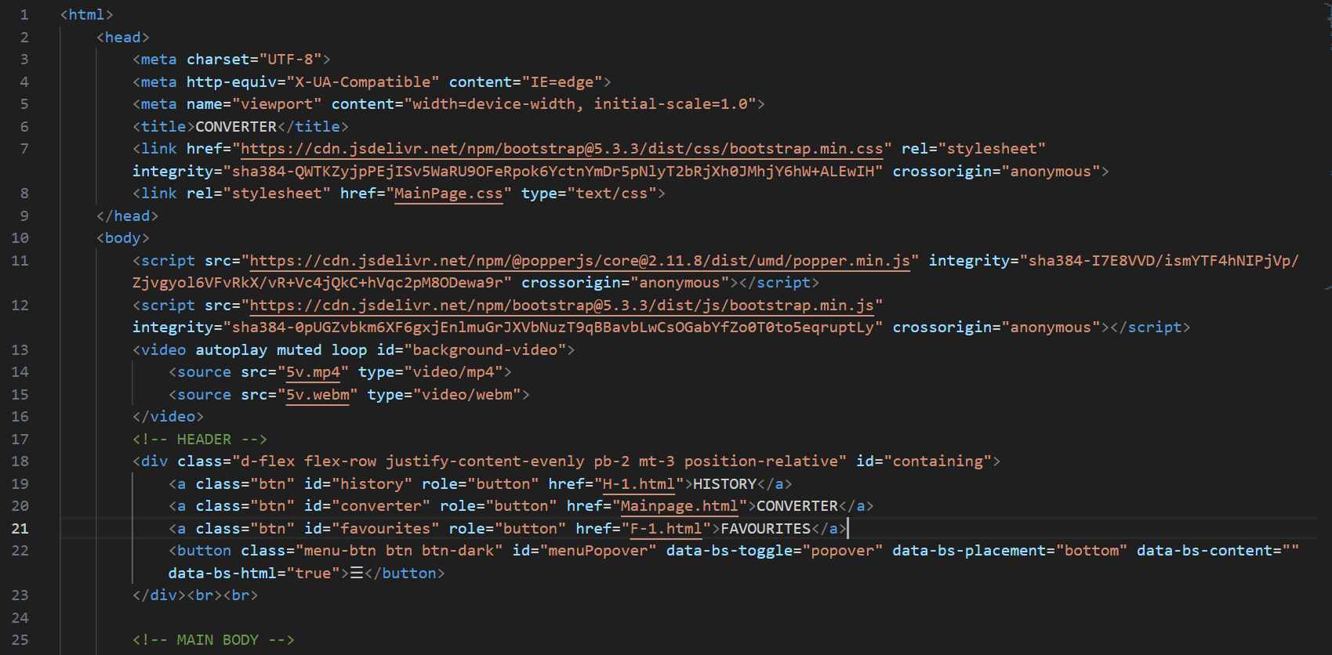
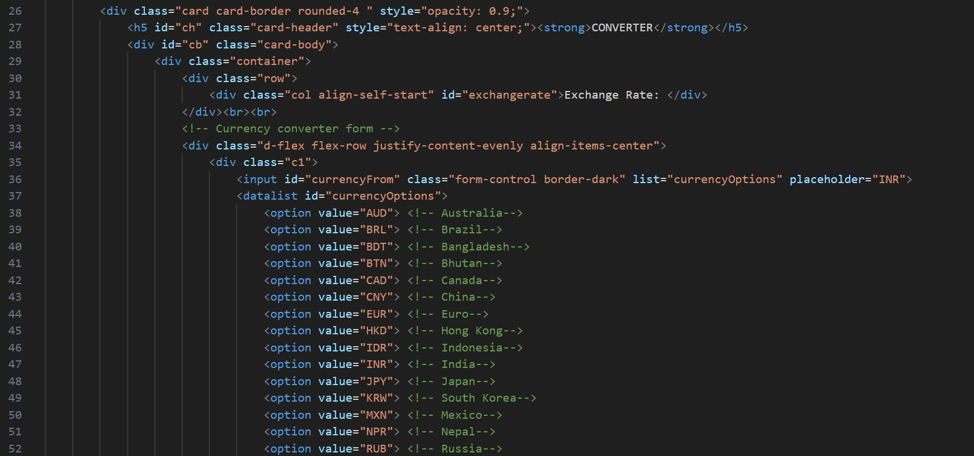
CODE FOR MAIN PAGE

Slide 17
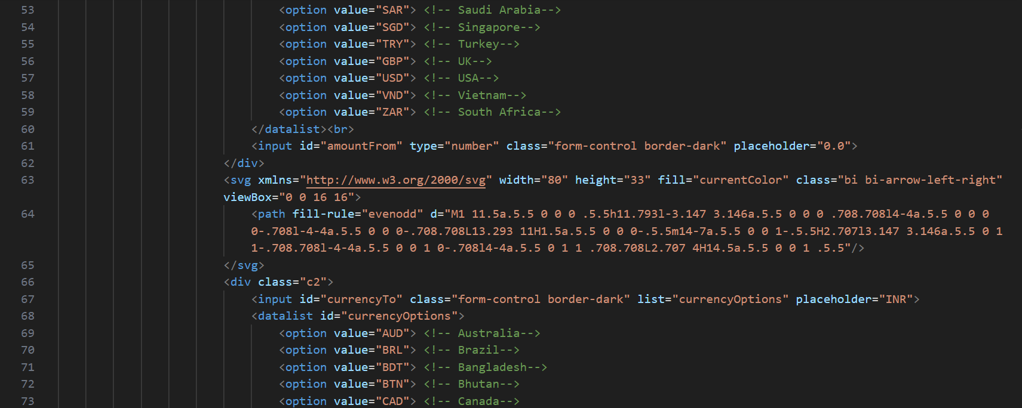
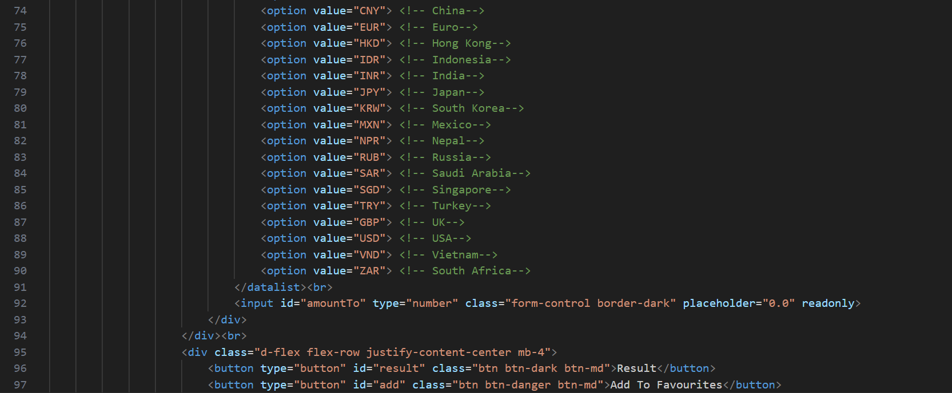

Slide 18
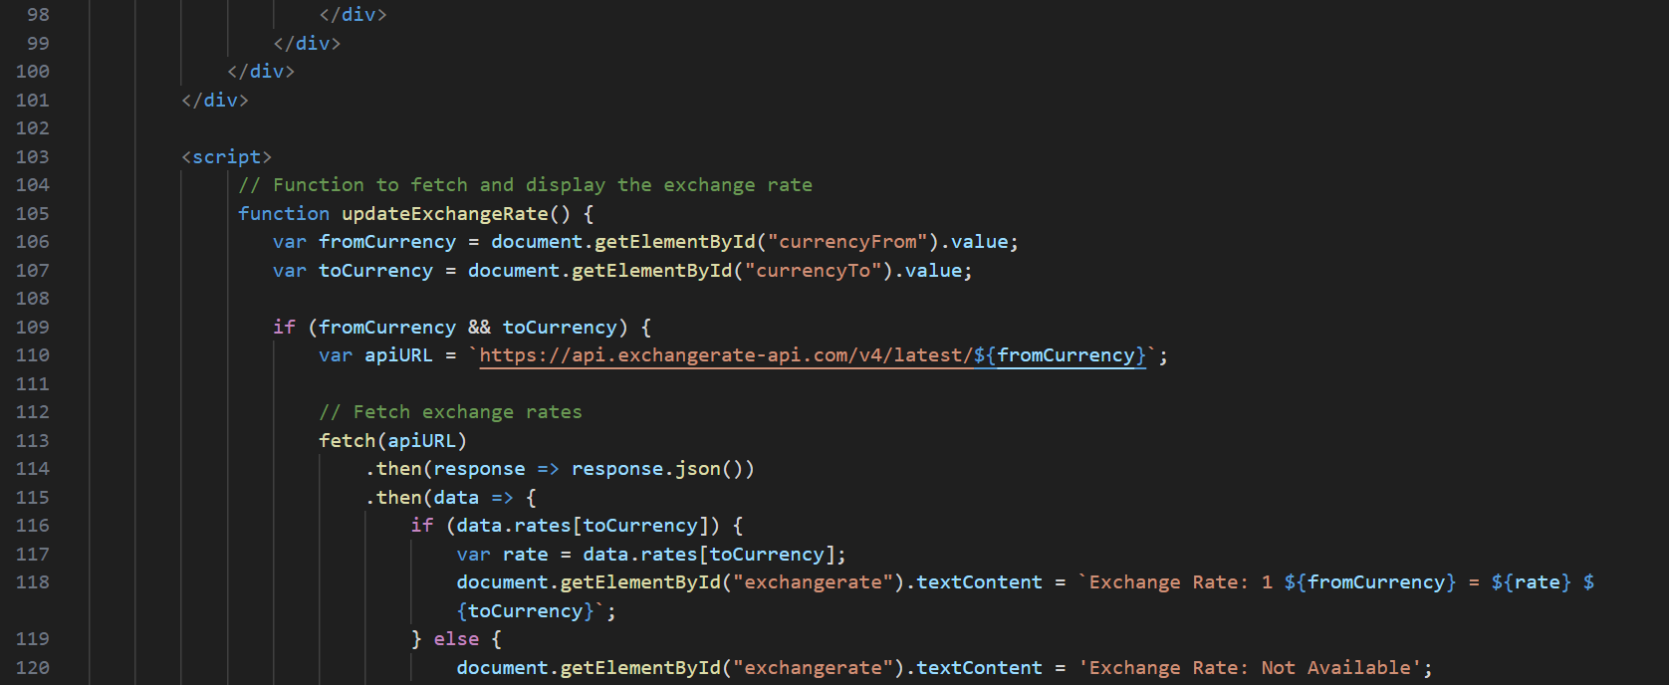
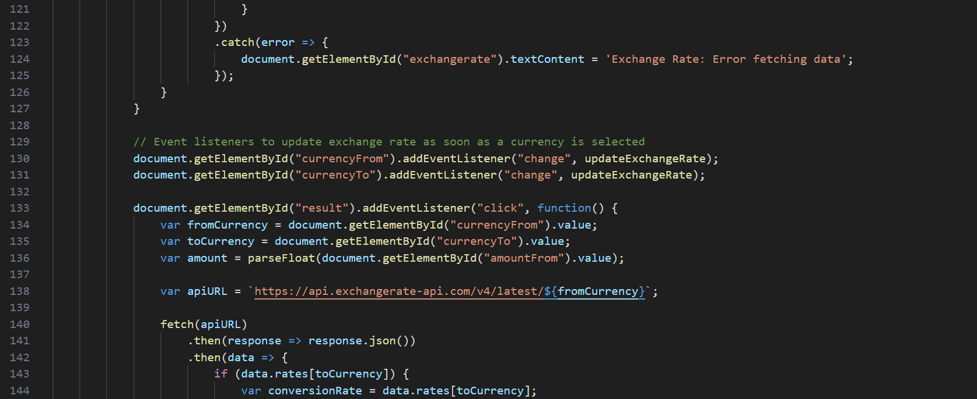

Slide 19
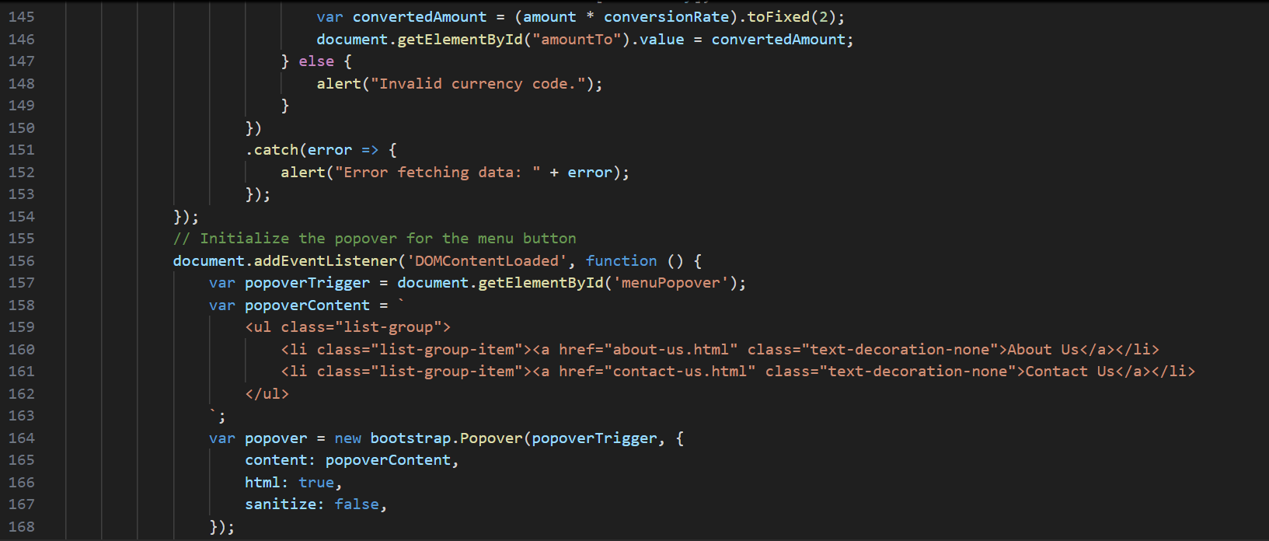
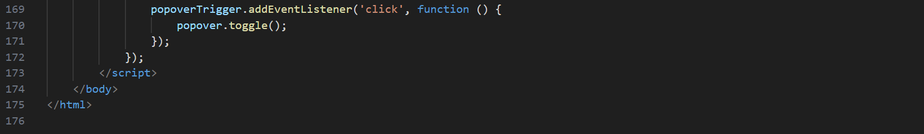

Slide 20
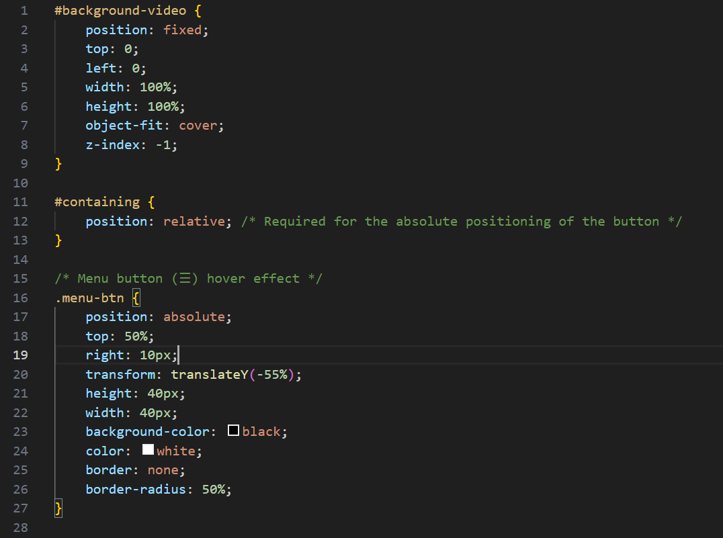
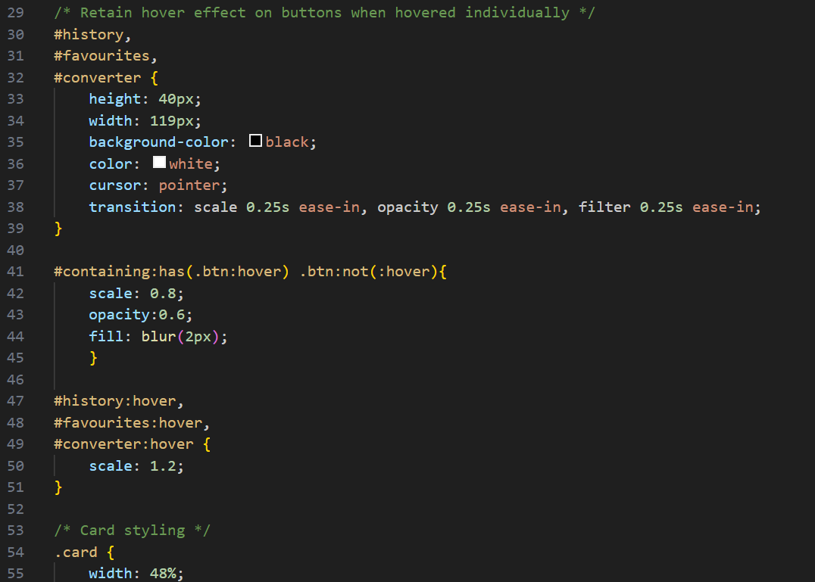
CODE OF CSS

Slide 21
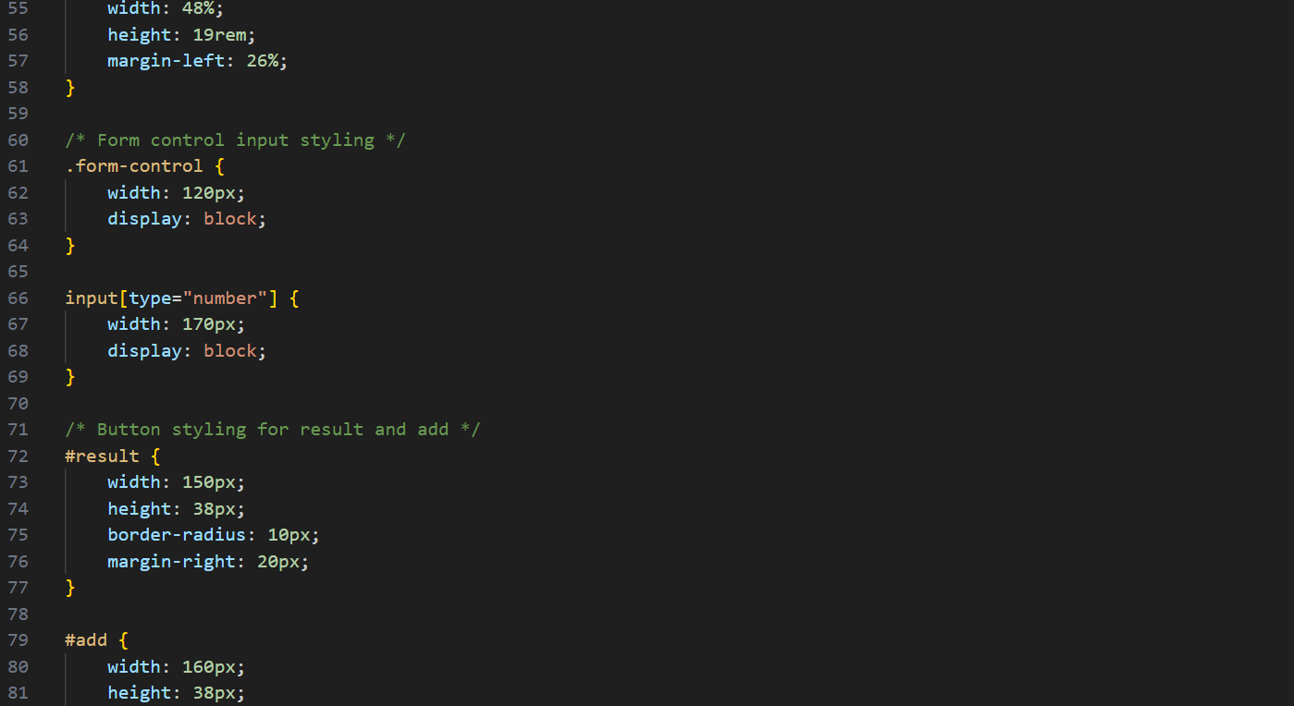

Slide 22
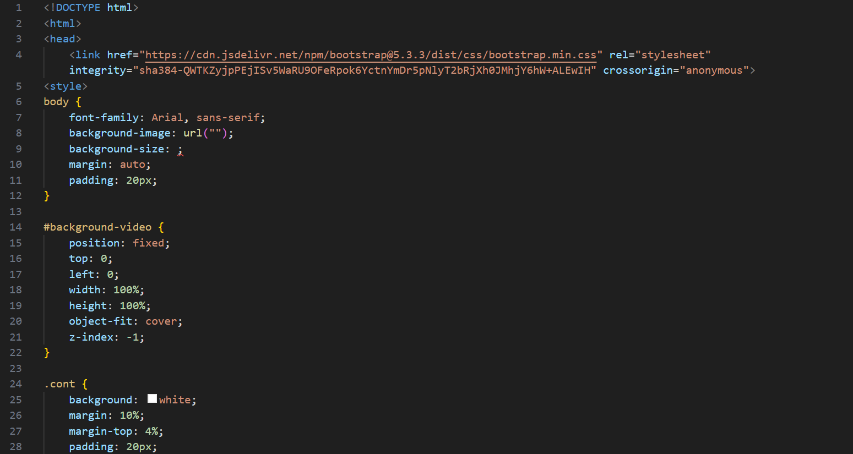
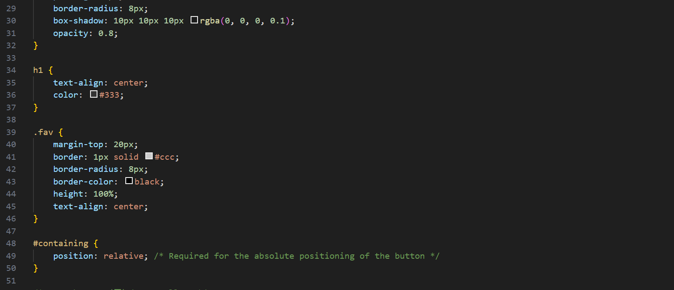
CODE FOR FAVOURITE PAGE

Slide 23
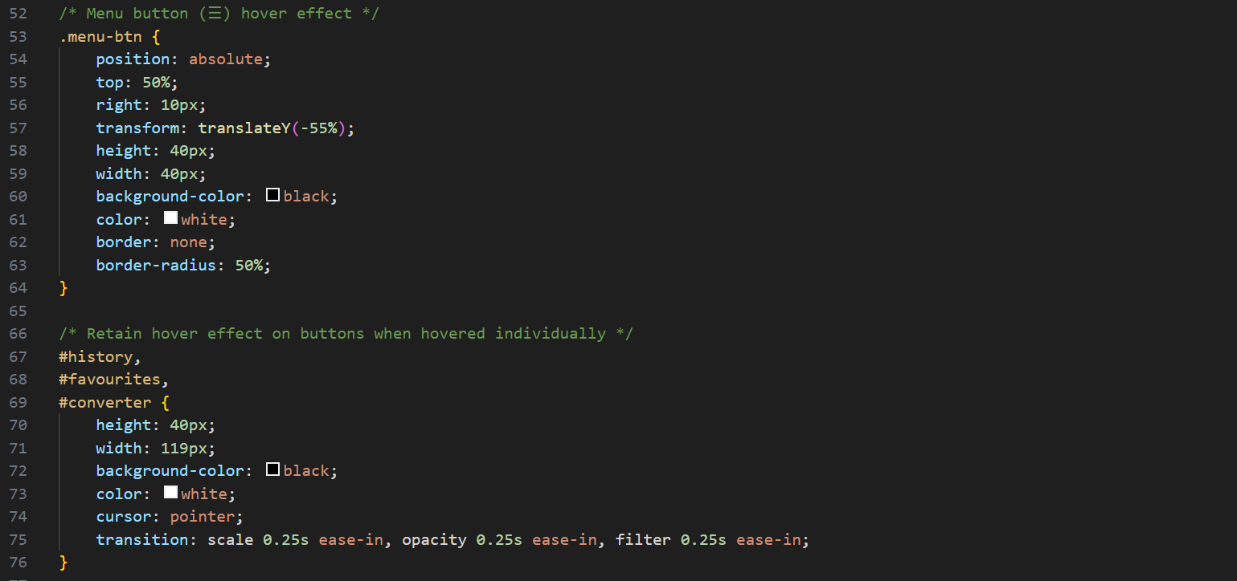
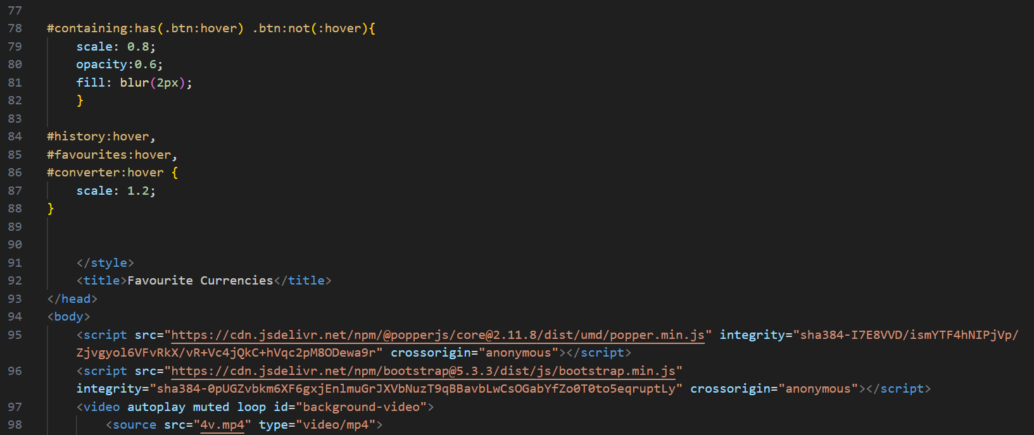

Slide 24
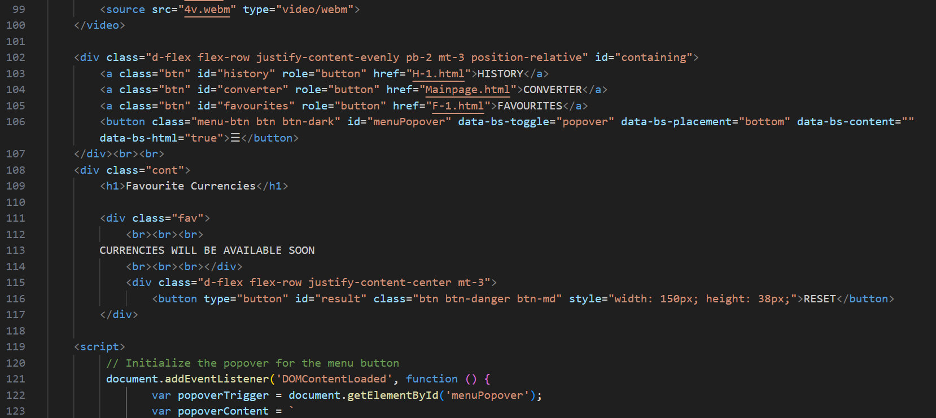
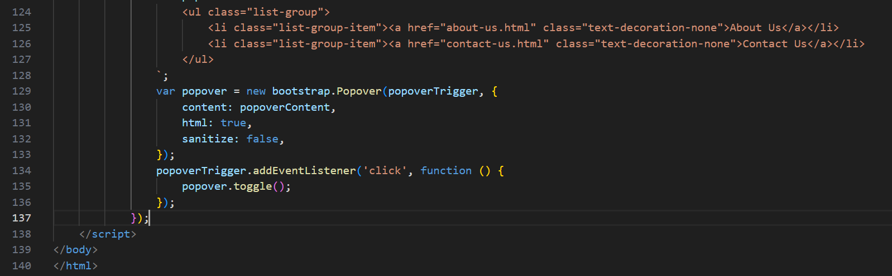

Slide 25
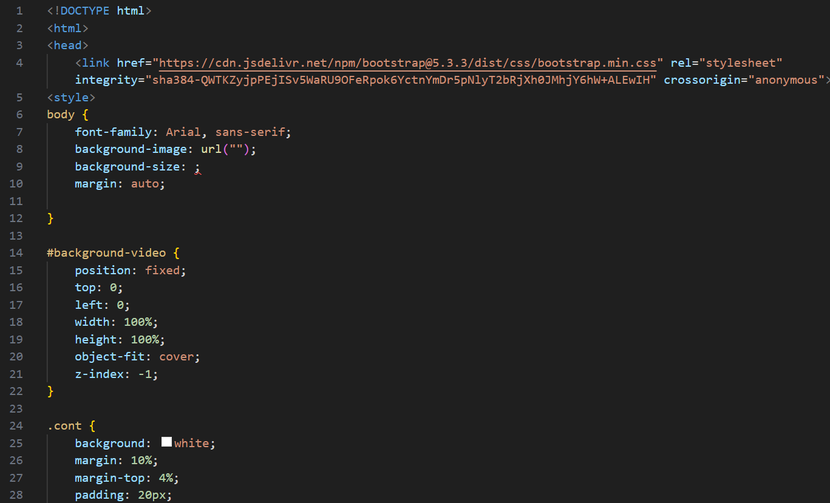
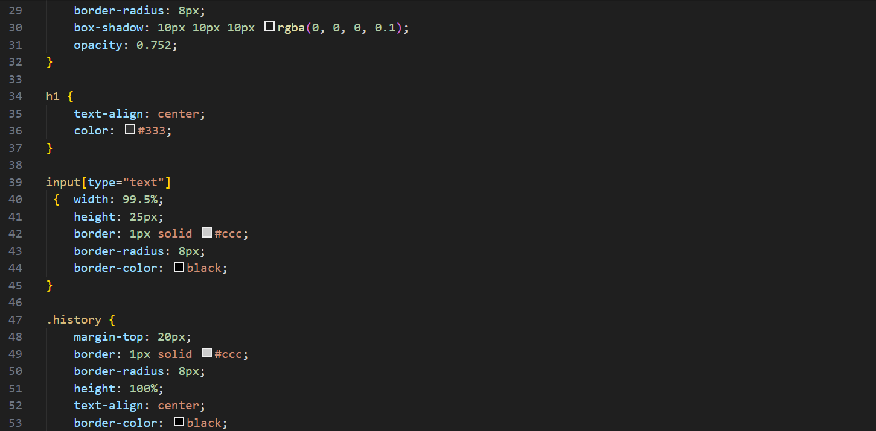
CODE FOR HISTORY PAGE

Slide 26
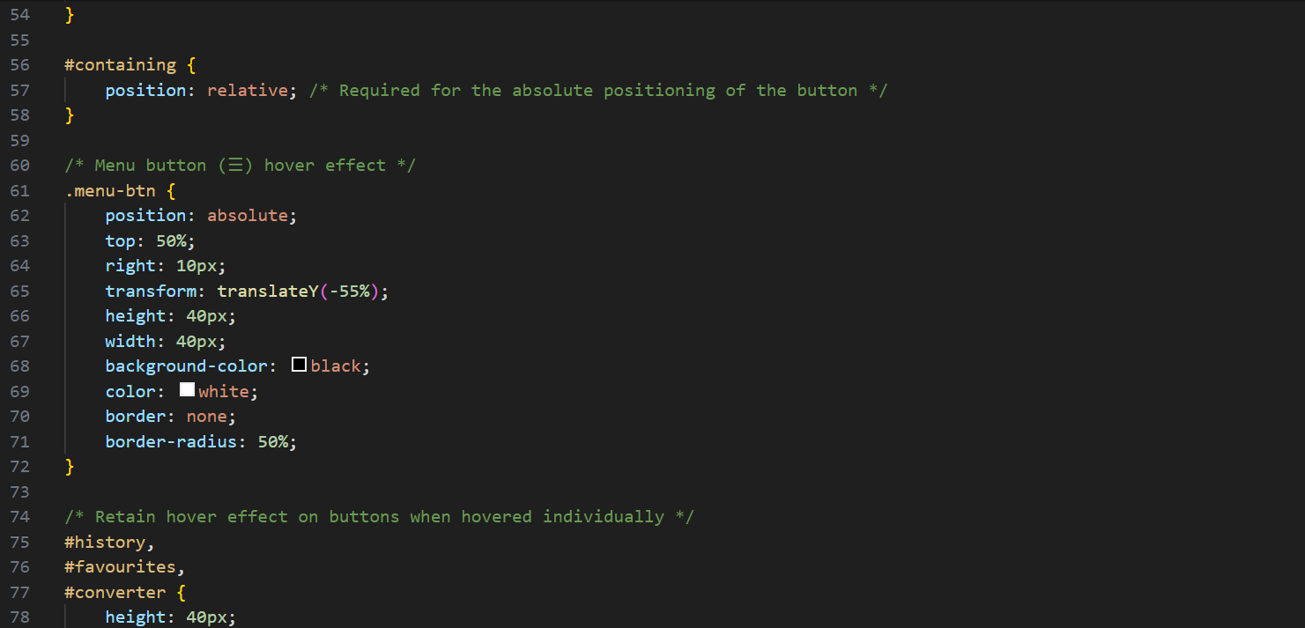
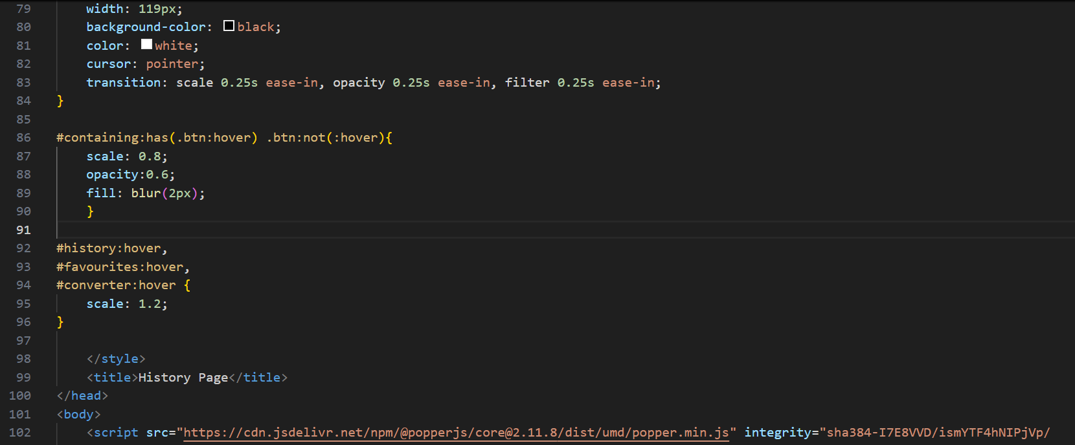

Slide 27
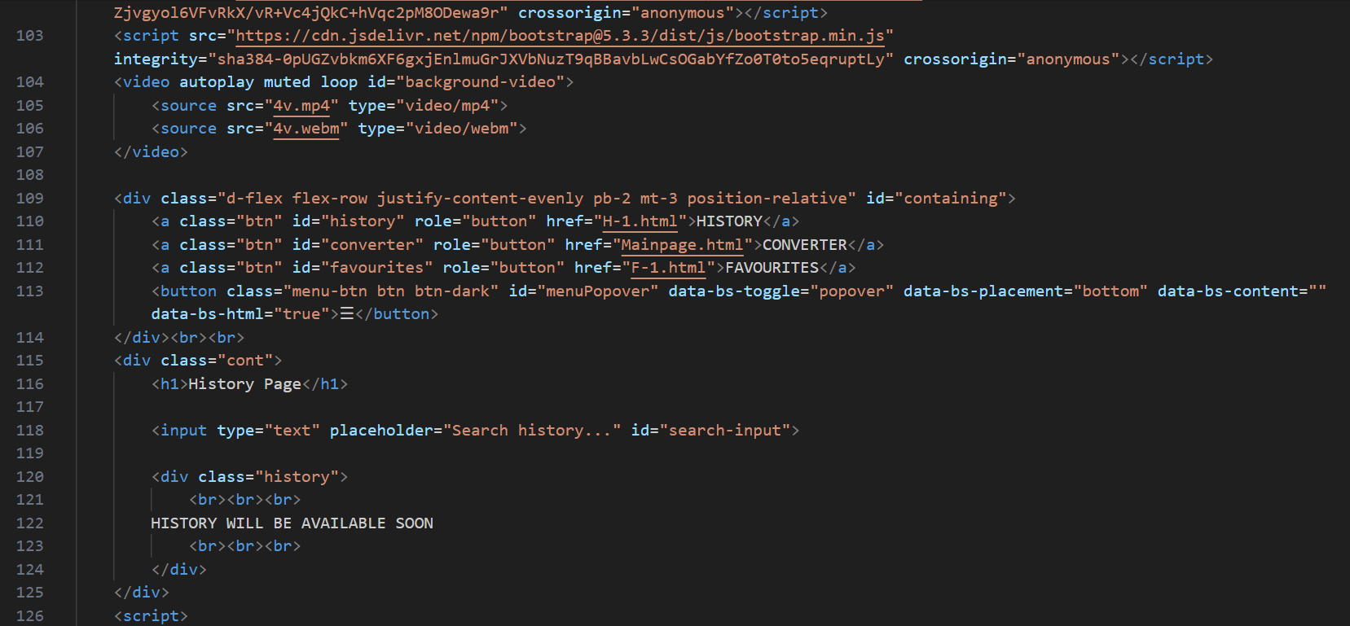
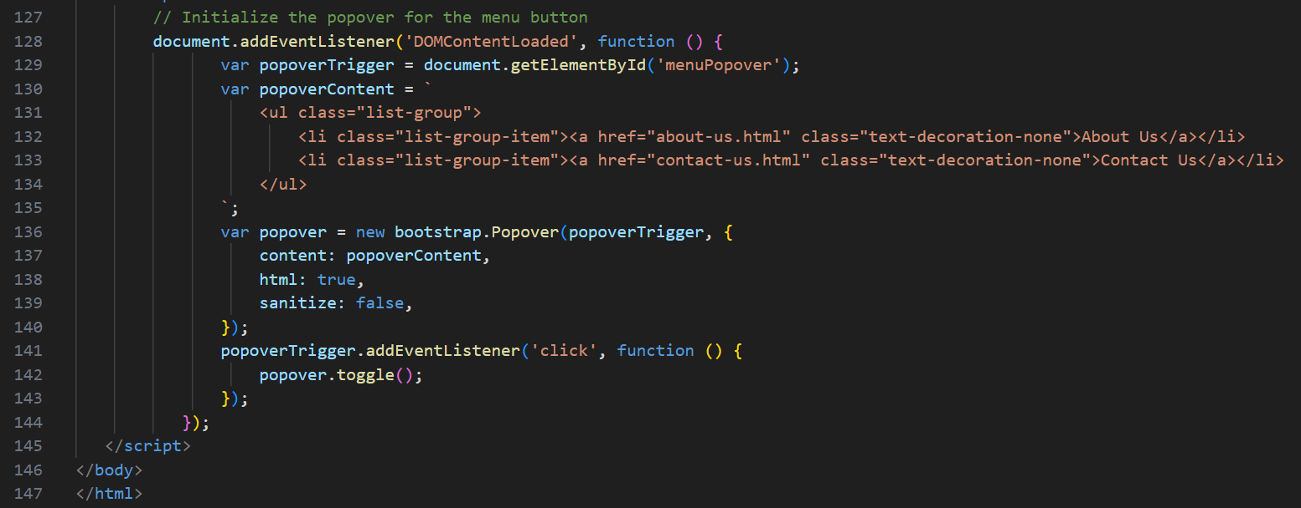

Slide 28
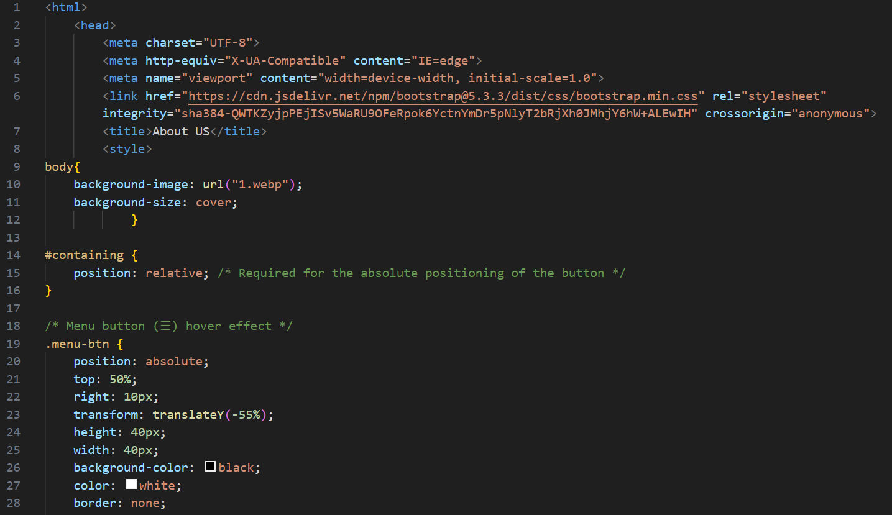
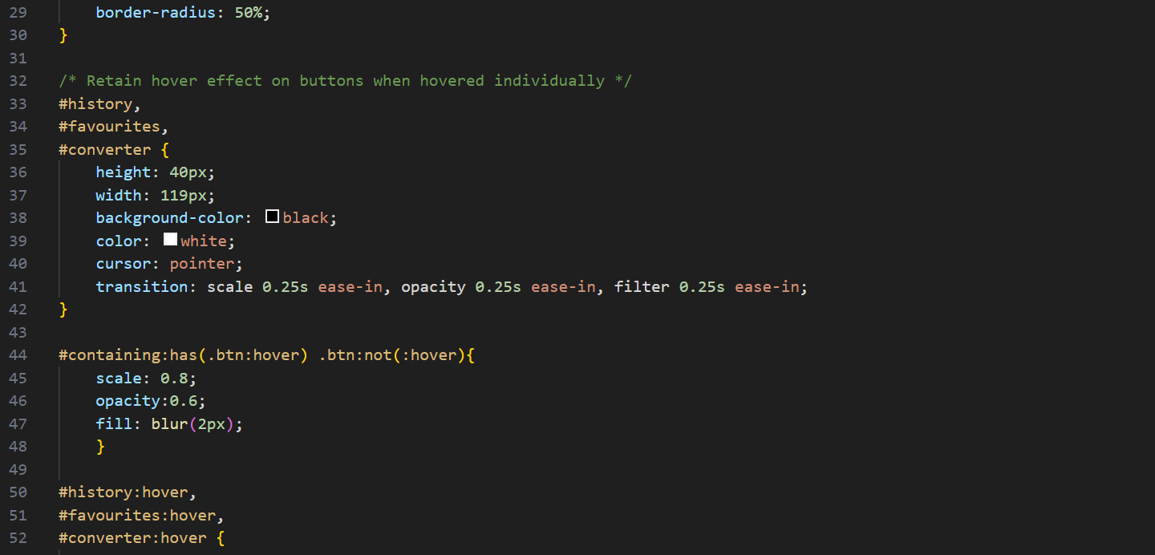
CODE FOR ABOUT US PAGE

Slide 29
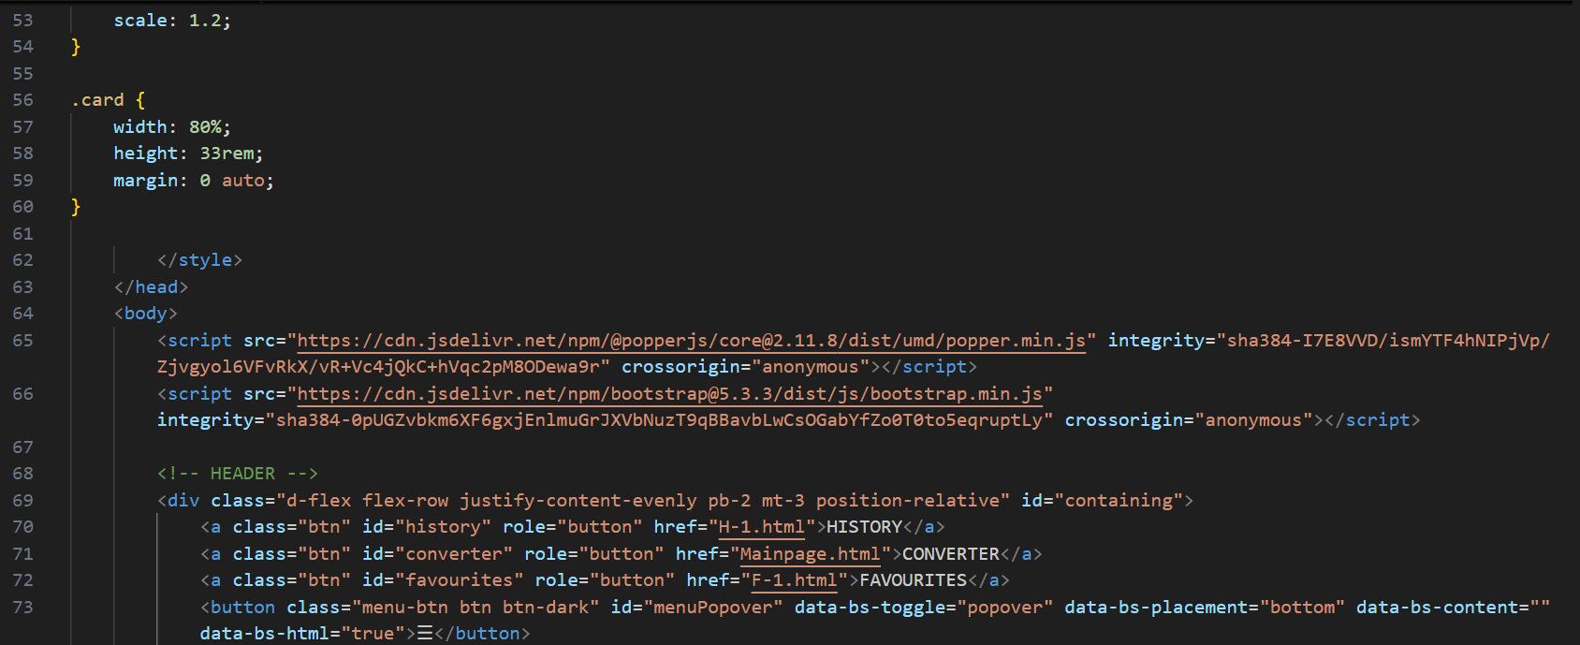
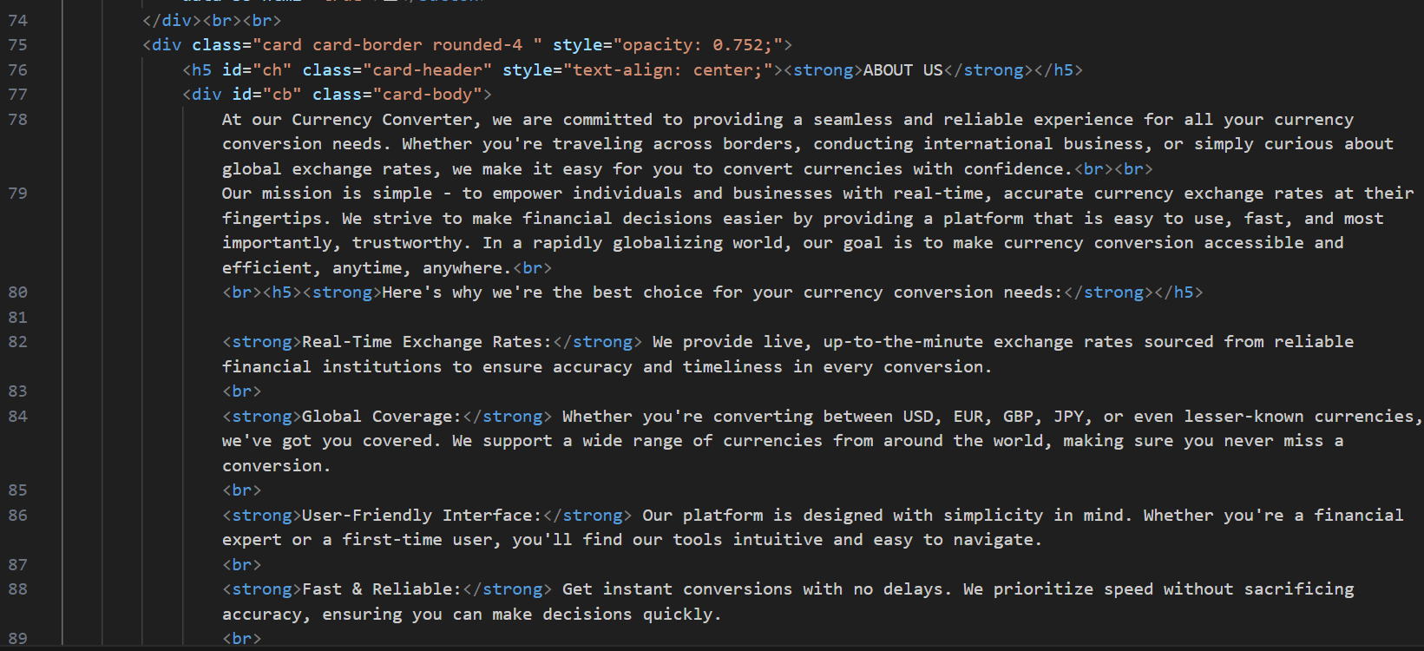

Slide 30
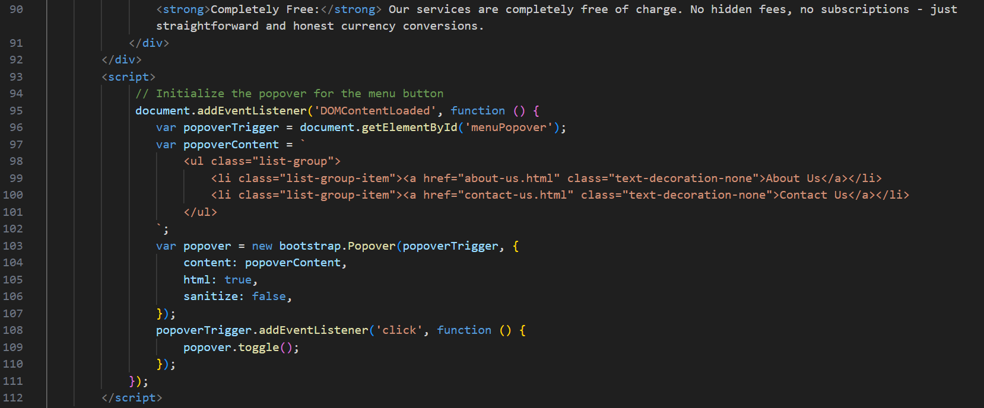

Slide 31
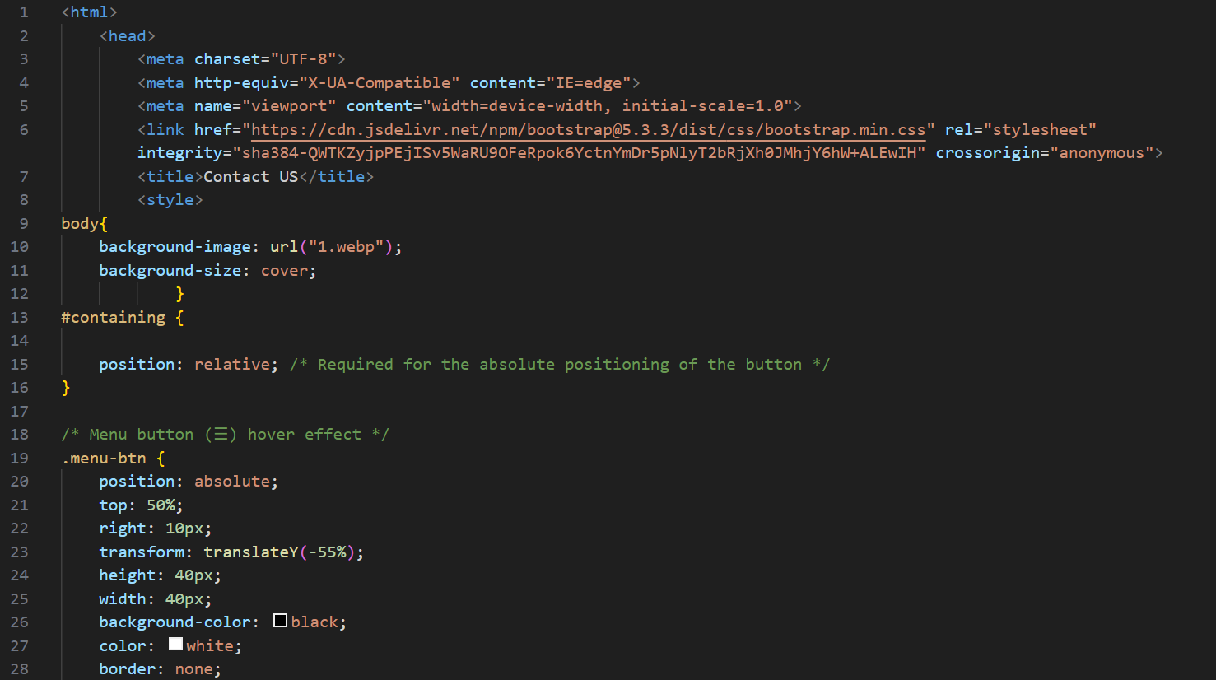
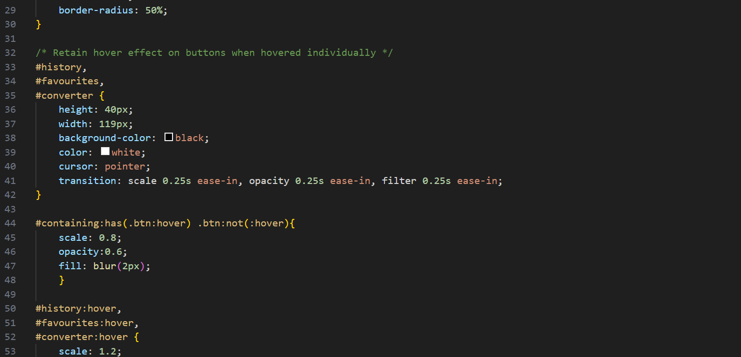
CODE FOR CONTACT US PAGE

Slide 32
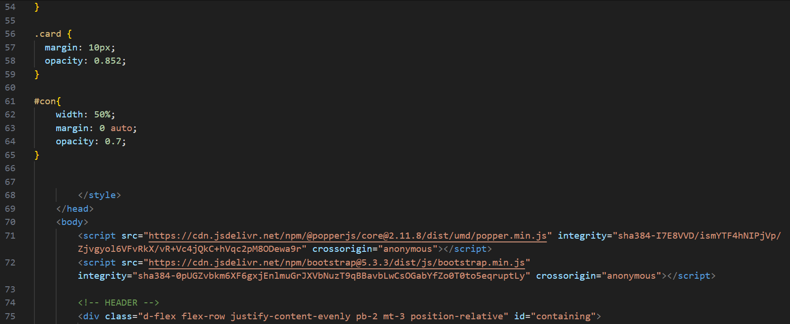
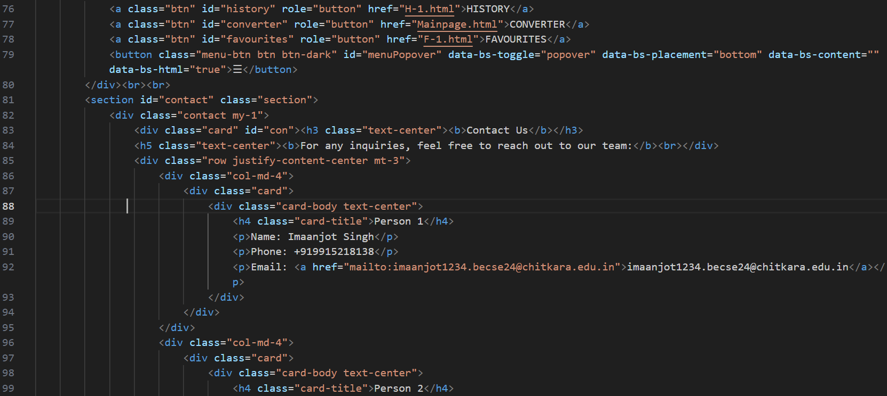

Slide 33
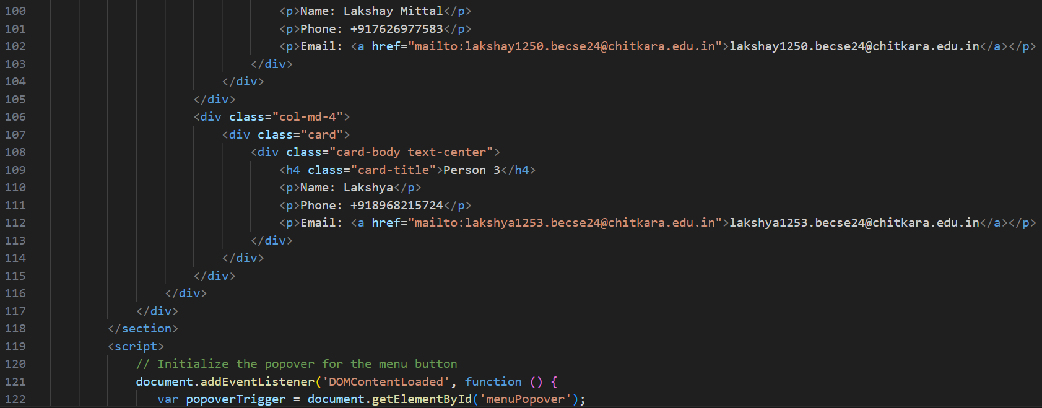
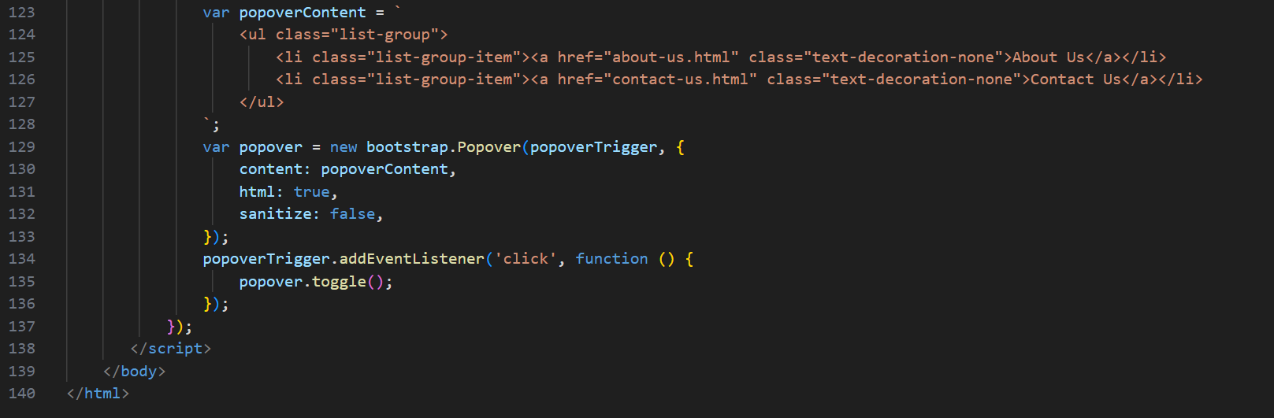

Slide 34
CONCLUSION
Our website provides fast and accurate conversions.
It ensures regular updates to reflect fluctuating exchange rates.
Features like history and favourite section provides a more personalized and user – friendly experience.

Slide 35
References/Links used
Links:
https://developer.mozilla.org/
https://www.w3schools.com
https://getbootstrap.com/
ChatGPT

Slide 36


